Slide 1
Solving problems by searching
Chapter-3

Slide 2
Problem solving agents
Problem can be defined through five components:
  Initial state
  Actions available
  Transition model (What each action does)
  Goal test
  Path cost
Different search solutions can solve these problems.
  We need different search algorithms that move the agent from one state to another to reach to the goal.

Slide 3
Uninformed search strategies
Uninformed strategies use only the information available in the problem definition.
Its also called blind search.
They have no additional information about states beyond that provided in problem definition.
  Breadth-first search
  Uniform-cost search
  Depth-first search
  Depth-limited search
  Iterative deepening search
Strategies that give preference to one non-goal state over other is informed search or heuristic search.

Slide 4
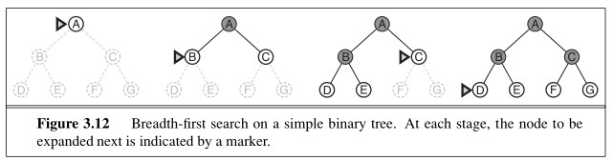
Breadth First Search
Root node is expanded first, then all the successor nodes are expanded. It uses FIFO bases search.
Completeness: Solution is found
Optimality: Breath first search is optimal if the path cost is a non-decreasing function of depth of the node
Time: Poor. For a uniform tree where every state has b successors. Time complexity is b + b² + b³ + · · · + b^{d} = O(b^{d}).
Space: Stores every expanded node in memory to prevent revisit. O(b^{d}).

Slide 5
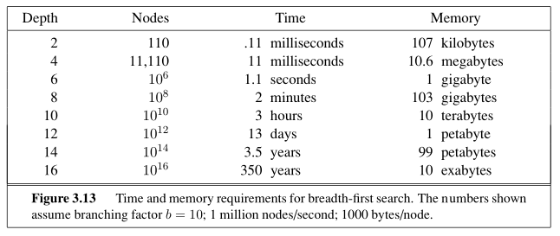
Breadth First Search
Memory requirements are a bigger problem.
Fortunately other search strategies require lesser memory.

Slide 6
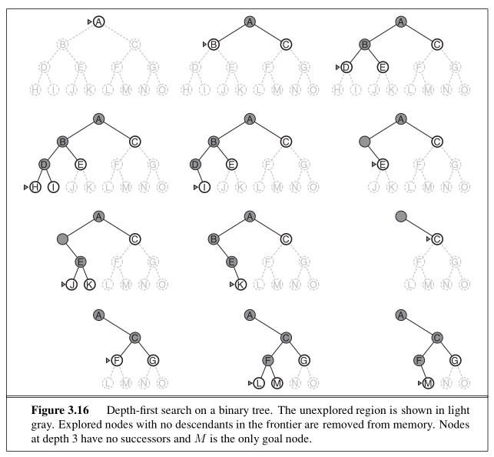
Depth First Search

Slide 7
Depth First Search
Expands the deepest node in current frontier. It uses LIFO based search.
Completeness:
  Solution is found in finite space.
  Fails in infinite depth space, or space with loops.
  Modify to avoid repeated states along the path.
Optimality: Breath first search is optimal if the path cost is a non-decreasing function of depth of the node
Time: Terrible O(b^{m}): Where m is the maximum depth of any node.
Space: Needs to store a single path. Once a leaf node is explored, we can remove it from memory. O(b.m), i.e., linear space!
  This is a clear advantage over breath first search.
  156 Kilo bytes instead of 10 exta bytes at depth = 16

Slide 8
Depth Limit Search
Failure of depth-first search in infinite state spaces can be alleviated by depth limit.
However, it also add another source of incompleteness if l < d.
Depth-First search with depth limit l, i.e. nodes at depth l have no successors.
Depth Limit search can be based on the knowledge of the problem.

Slide 9
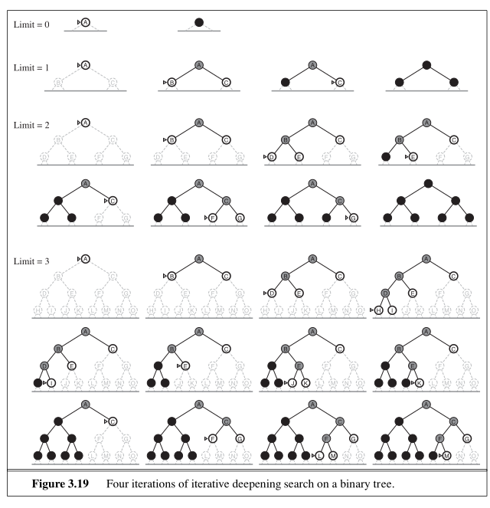
Iterative deepening Depth First Search
General strategy that finds the best depth limit.
It gradually increases the limit.

Slide 10
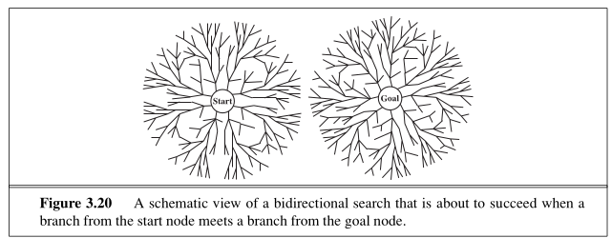
Bidirectional search
General strategy that finds the best depth limit.
It gradually increases the limit.

Slide 11
Informed search strategies
Informed search strategies use problem specific knowledge to find solution more efficiently.
  Best First Search
  Greedy First search
  A* search
  Memory bounded heuristic search

Slide 12
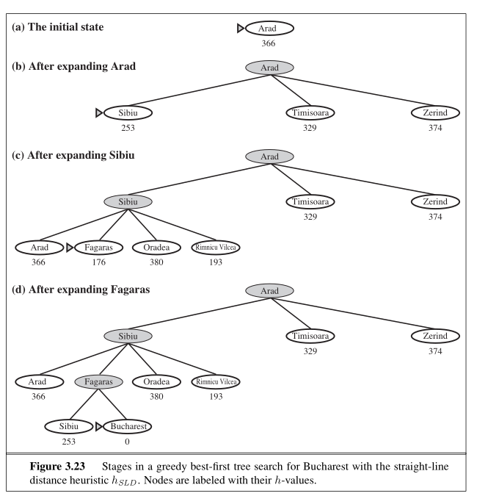
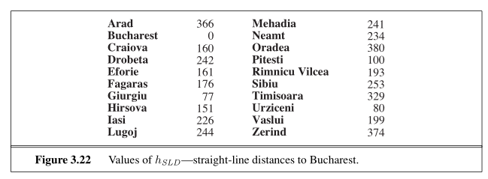
Greedy best first search
Tries to expand the node that is closest to the goal.
  It is likely to lead to a solution quickly.
Straight line distances are shown

Slide 13
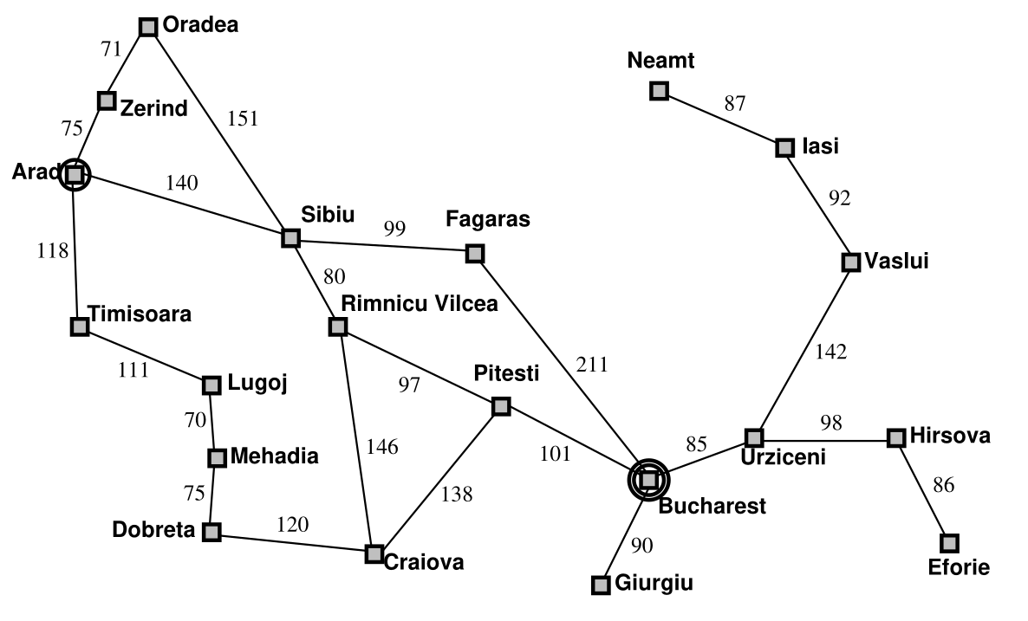
Greedy best first search

